Slide 1
CSE 471: MACHINE LEARNING
GAN Loss function

Slide 2

Discriminator Loss
Labels
  y = 1 => True data
  y = 0 => Fake data
We train the discriminator to minimize the cross-entropy loss

Slide 3

Generator Loss
The goal of the generator is to fool the discriminator to classify G(z) as true data, i.e., we want D(G(z)) ≈ 1
For a given discriminator, we update the parameters of the generator to maximize the cross-entropy loss when y = 0

Slide 4
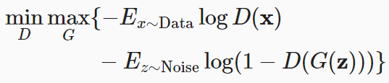
Combining the two
D and G are playing a “minimax” game with the comprehensive objective function:

